Slide 1
Chapter 5: Confidentiality Policies
Overview
  What is a confidentiality model
Bell-LaPadula Model
  General idea
  Informal description of rules

Slide 2
Overview
Goals of Confidentiality Model
Bell-LaPadula Model
  Informally
  Example Instantiation

Slide 3
Confidentiality Policy
Goal: prevent the unauthorized disclosure of information
  Deals with information flow
  Integrity incidental
Multi-level security models are best-known examples
  Bell-LaPadula Model basis for many, or most, of these

Slide 4
Bell-LaPadula Model, Step 1
Security levels arranged in linear ordering
  Top Secret: highest
  Secret
  Confidential
  Unclassified: lowest
Levels consist of security clearance L(s)
  Objects have security classification L(o)

Slide 5
Example
security level | subject | object
Top Secret | Tamara | Personnel Files
Secret | Samuel | E-Mail Files
Confidential | Claire | Activity Logs
Unclassified | Ulaley | Telephone Lists
Tamara can read all files
Claire cannot read Personnel or E-Mail Files
Ulaley can only read Telephone Lists

Slide 6
Reading Information
Information flows up, not down
  “Reads up” disallowed, “reads down” allowed
Simple Security Condition (Step 1)
  Subject s can read object o iff L(o) ≤ L(s) and s has permission to read o
    Note: combines mandatory control (relationship of security levels) and discretionary control (the required permission)
  Sometimes called “no reads up” rule

Slide 7
Writing Information
Information flows up, not down
  “Writes up” allowed, “writes down” disallowed
*-Property (Step 1)
  Subject s can write object o iff L(s) ≤ L(o) and s has permission to write o
    Note: combines mandatory control (relationship of security levels) and discretionary control (the required permission)
  Sometimes called “no writes down” rule

Slide 8
Basic Security Theorem, Step 1
If a system is initially in a secure state, and every transition of the system satisfies the simple security condition, step 1, and the *-property, step 1, then every state of the system is secure
  Proof: induct on the number of transitions

Slide 9
Bell-LaPadula Model, Step 2
Expand notion of security level to include categories
Security level is (clearance, category set)
Examples
  ( Top Secret, { NUC, EUR, ASI } )
  ( Confidential, { EUR, ASI } )
  ( Secret, { NUC, ASI } )

Slide 10
Levels and Lattices
(A, C) dom (A′, C′) iff A′ ≤ A and C′ ⊆ C
Examples
  (Top Secret, {NUC, ASI}) dom (Secret, {NUC})
  (Secret, {NUC, EUR}) dom (Confidential,{NUC, EUR})
  (Top Secret, {NUC}) ¬dom (Confidential, {EUR})
Let C be set of classifications, K set of categories. Set of security levels L = C × K, dom form lattice
  lub(L) = (max(A), C)
  glb(L) = (min(A), ∅)

Slide 11
Levels and Ordering
Security levels partially ordered
  Any pair of security levels may (or may not) be related by dom
“dominates” serves the role of “greater than” in step 1
  “greater than” is a total ordering, though

Slide 12
Reading Information
Information flows up, not down
  “Reads up” disallowed, “reads down” allowed
Simple Security Condition (Step 2)
  Subject s can read object o iff L(s) dom L(o) and s has permission to read o
    Note: combines mandatory control (relationship of security levels) and discretionary control (the required permission)
  Sometimes called “no reads up” rule

Slide 13
Writing Information
Information flows up, not down
  “Writes up” allowed, “writes down” disallowed
*-Property (Step 2)
  Subject s can write object o iff L(o) dom L(s) and s has permission to write o
    Note: combines mandatory control (relationship of security levels) and discretionary control (the required permission)
  Sometimes called “no writes down” rule

Slide 14
Basic Security Theorem, Step 2
If a system is initially in a secure state, and every transition of the system satisfies the simple security condition, step 2, and the *-property, step 2, then every state of the system is secure
  Proof: induct on the number of transitions
  In actual Basic Security Theorem, discretionary access control treated as third property, and simple security property and *-property phrased to eliminate discretionary part of the definitions — but simpler to express the way done here.

Slide 15
Problem
Colonel has (Secret, {NUC, EUR}) clearance
Major has (Secret, {EUR}) clearance
  Major can talk to colonel (“write up” or “read down”)
  Colonel cannot talk to major (“read up” or “write down”)
Clearly absurd!

Slide 16
Solution
Define maximum, current levels for subjects
  maxlevel(s) dom curlevel(s)
Example
  Treat Major as an object (Colonel is writing to him/her)
  Colonel has maxlevel (Secret, { NUC, EUR })
  Colonel sets curlevel to (Secret, { EUR })
  Now L(Major) dom curlevel(Colonel)
    Colonel can write to Major without violating “no writes down”
  Does L(s) mean curlevel(s) or maxlevel(s)?
    Formally, we need a more precise notation

Slide 17
DG/UX System
Provides mandatory access controls
  MAC label identifies security level
  Default labels, but can define others
Initially
  Subjects assigned MAC label of parent
    Initial label assigned to user, kept in Authorization and Authentication database
  Object assigned label at creation
    Explicit labels stored as part of attributes
    Implicit labels determined from parent directory

Slide 18
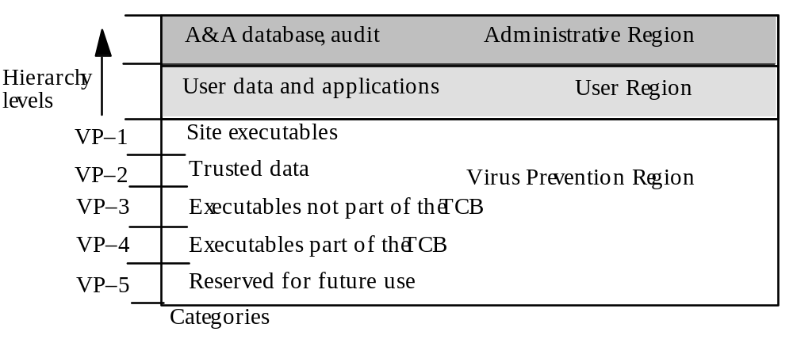
MAC Regions
IMPL_HI is “maximum” (least upper bound) of all levels
IMPL_LO is “minimum” (greatest lower bound) of all levels

Slide 19
Directory Problem
Process p at MAC_A tries to create file /tmp/x
/tmp/x exists but has MAC label MAC_B
  Assume MAC_B dom MAC_A
Create fails
  Now p knows a file named x with a higher label exists
Fix: only programs with same MAC label as directory can create files in the directory
  Now compilation won’t work, mail can’t be delivered

Slide 20
Multilevel Directory
Directory with a set of subdirectories, one per label
  Not normally visible to user
  p creating /tmp/x actually creates /tmp/d/x where d is directory corresponding to MAC_A
  All p’s references to /tmp go to /tmp/d
p cd’s to /tmp/a, then to ..
  System call stat(“.”, &buf) returns inode number of real directory
  System call dg_stat(“.”, &buf) returns inode of /tmp

Slide 21
Object Labels
Requirement: every file system object must have MAC label
Roots of file systems have explicit MAC labels
  If mounted file system has no label, it gets label of mount point
Object with implicit MAC label inherits label of parent

Slide 22
Object Labels
Problem: object has two names
  /x/y/z, /a/b/c refer to same object
  y has explicit label IMPL_HI
  b has explicit label IMPL_B
Case 1: hard link created while file system on DG/UX system, so …
Creating hard link requires explicit label
  If implicit, label made explicit
  Moving a file makes label explicit

Slide 23
Object Labels
Case 2: hard link exists when file system mounted
  No objects on paths have explicit labels: paths have same implicit labels
  An object on path acquires an explicit label: implicit label of child must be preserved
so …
Change to directory label makes child labels explicit before the change

Slide 24
Object Labels
Symbolic links are files, and treated as such, so …
When resolving symbolic link, label of object is label of target of the link
  System needs access to the symbolic link itself

Slide 25
Using MAC Labels
Simple security condition implemented
*-property not fully implemented
  Process MAC must equal object MAC
  Writing allowed only at same security level
Overly restrictive in practice

Slide 26
MAC Tuples
Up to 3 MAC ranges (one per region)
MAC range is a set of labels with upper, lower bound
  Upper bound must dominate lower bound of range
Examples
  [(Secret, {NUC}), (Top Secret, {NUC})]
  [(Secret, ∅), (Top Secret, {NUC, EUR, ASI})]
  [(Confidential, {ASI}), (Secret, {NUC, ASI})]

Slide 27
MAC Ranges
[(Secret, {NUC}), (Top Secret, {NUC})]
[(Secret, ∅), (Top Secret, {NUC, EUR, ASI})]
[(Confidential, {ASI}), (Secret, {NUC, ASI})]
(Top Secret, {NUC}) in ranges 1, 2
(Secret, {NUC, ASI}) in ranges 2, 3
[(Secret, {ASI}), (Top Secret, {EUR})] not valid range
  as (Top Secret, {EUR}) ¬dom (Secret, {ASI})

Slide 28
Objects and Tuples
Objects must have MAC labels
  May also have MAC label
  If both, tuple overrides label
Example
  Paper has MAC range:
  [(Secret, {EUR}), (Top Secret, {NUC, EUR})]

Slide 29
MAC Tuples
Process can read object when:
  Object MAC range (lr, hr); process MAC label pl
  pl dom hr
    Process MAC label grants read access to upper bound of range
Example
  Peter, with label (Secret, {EUR}), cannot read paper
    (Top Secret, {NUC, EUR}) dom (Secret, {EUR})
  Paul, with label (Top Secret, {NUC, EUR, ASI}) can read paper
    (Top Secret, {NUC, EUR, ASI}) dom (Top Secret, {NUC, EUR})

Slide 30
MAC Tuples
Process can write object when:
  Object MAC range (lr, hr); process MAC label pl
  pl ∈ (lr, hr)
    Process MAC label grants write access to any label in range
Example
  Peter, with label (Secret, {EUR}), can write paper
    (Top Secret, {NUC, EUR}) dom (Secret, {EUR}) and (Secret, {EUR}) dom (Secret, {EUR})
  Paul, with label (Top Secret, {NUC, EUR, ASI}), cannot read paper
    (Top Secret, {NUC, EUR, ASI}) dom (Top Secret, {NUC, EUR})

Slide 31
Key Points
Confidentiality models restrict flow of information
Bell-LaPadula models multilevel security
  Cornerstone of much work in computer security

